Slide 1
D-310 Unit 3: Supplies

Slide 2
Objectives
Students will be able to:
Mobilize supplies in a cost-effective manner to meet time frames.
Describe procedures unique to supplies, such as National Fire Equipment Catalog (NFES) items, local procurement, Buying Team (BUYT), etc.
Utilize the NWCG NFES Catalog to accurately process supply orders specific to the catalog number, the catalog description, and the unit of issue for cache supply items.
Identify the location of national and local support caches and explain how closest forces and time frames affect mobilization and demobilization.
Describe the interaction the supply dispatcher must have with other functional areas within the incident support organization.

Slide 3

Incident Position Standards Alignment
This unit aligns with the following Expanded Dispatch Support Dispatcher (EDSD) Incident Position Standards located at
https://www.nwcg.gov/positions/expanded-dispatch-support-dispatcher/standards-and-references.
EDSD responsibility alignment
Review and manage existing requests.
Receive and manage new requests.
Communicate and manage resources in preparation for reassignment or demobilization.
Perform effectively in each of the four functional areas.
Establish and maintain communication with frequent contacts.

Slide 4
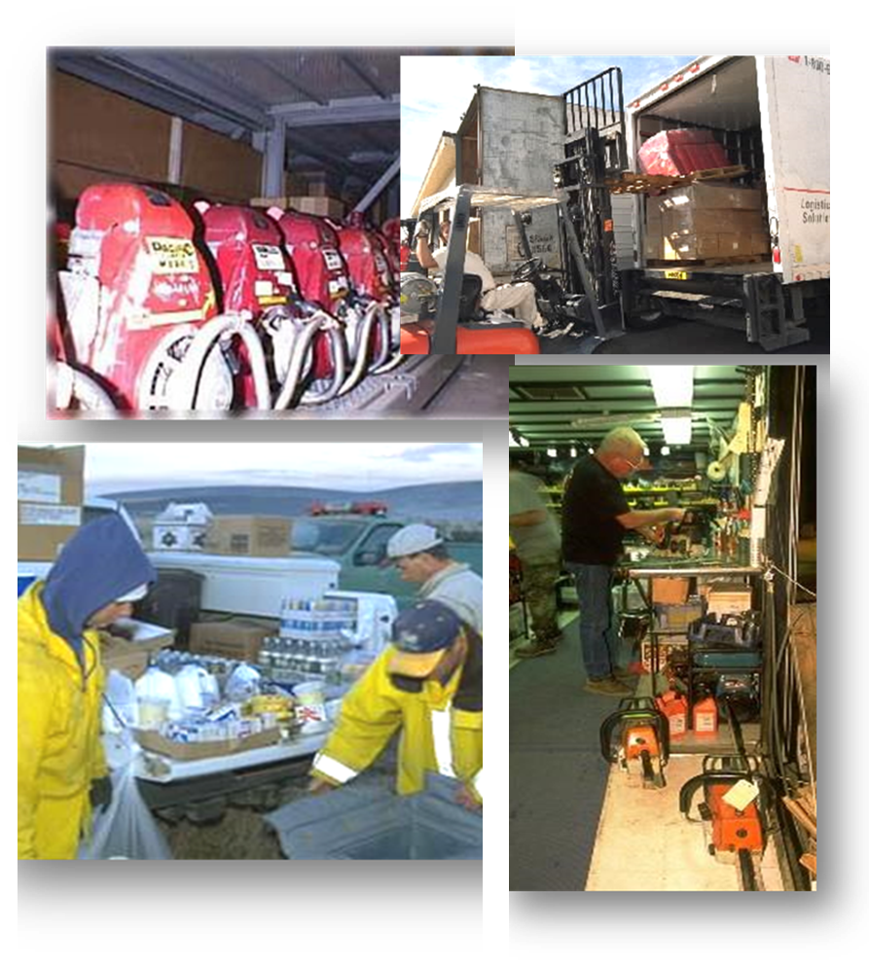
Supply Items
Supplies are materials or goods not defined in any other resource or service category.
NFES items
Mobile cache vans
Services
Locally purchased items

Slide 5
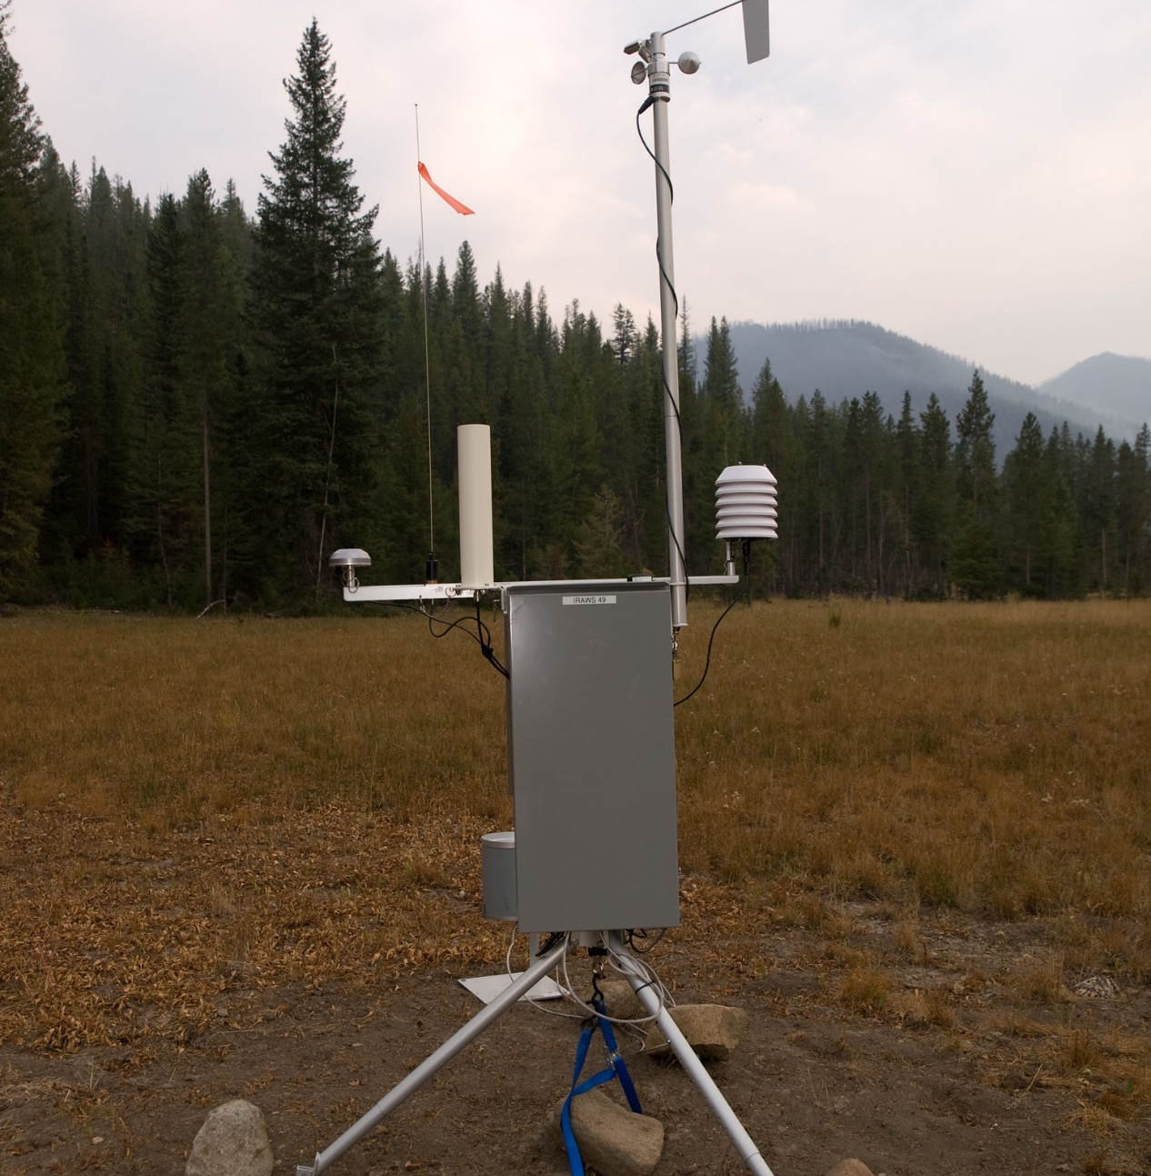
National Resources
Shared – limited number available
Remote Automatic Weather Stations (RAWS)
National Interagency Incident Communications Division (NIICD)
Notes:
FS_BeaverCreekFire_009 | Remote Automatic Weather Stations p… | Flickr

Slide 6
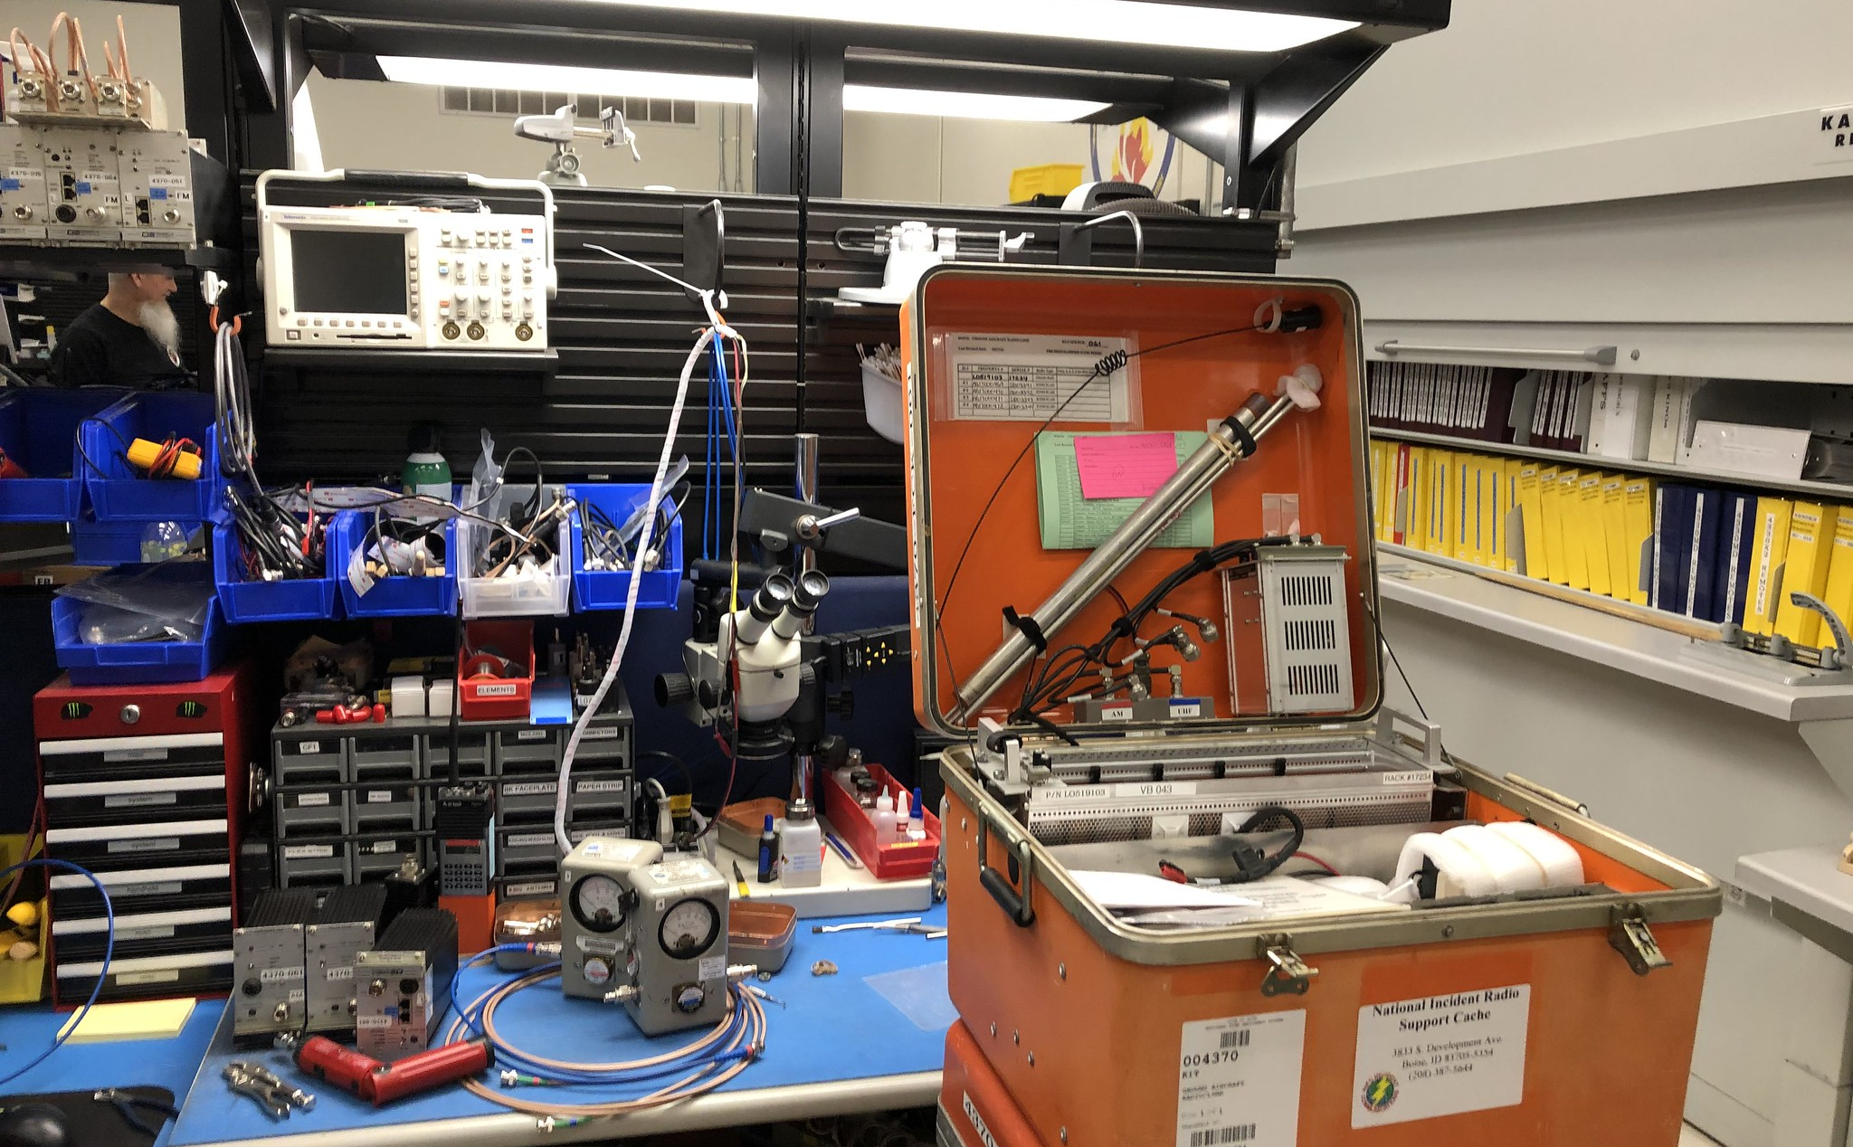
NIICD
Notes:
The Radio Shop | The National Interagency Incident Radio Sup… | Flickr

Slide 7
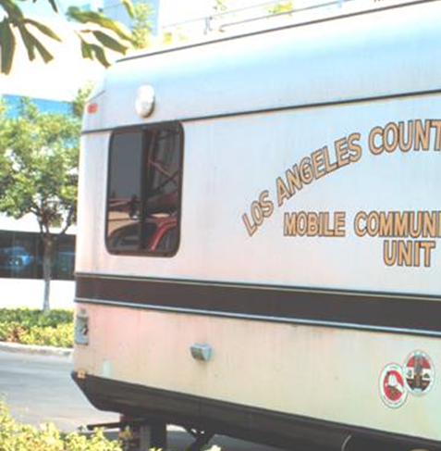
Other Radio Systems
Area communications trailers (non-standard)
NFES items/numbers unique to the region

Slide 8
Incident Command System (ICS) Starter System (NFES 004390)
Components:
3 each Command (CMD)/Tactical (TAC) Radio Kit, 48 radios (NFES 004381)
1 each CMD/TAC Repeater Kit (NFES 004312)
1 each Ground to Aircraft Radio/Link Kit (NFES 004370)
2 each Remote Kit (NFES 004330)
1 each Logistics Repeater Kit (NFES 004248)
1 each Logistics Radio Kit, 16 radios (NFES 004244)
5 each Sealed Lead Acid (SLA) Battery Kit (NFES 004510)

Slide 9
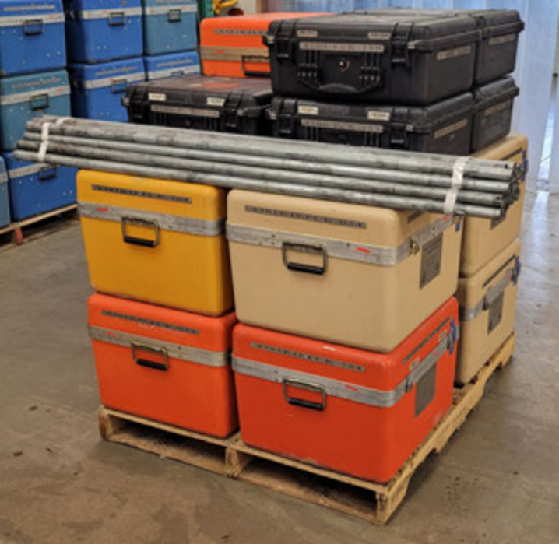
NFES 004390 Starter System Pallet

Slide 10
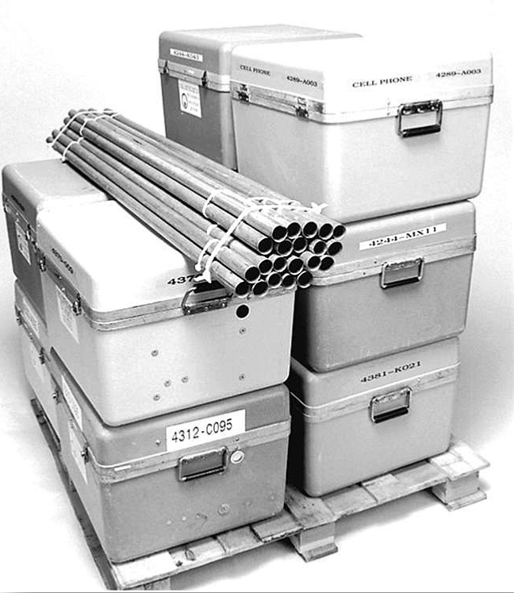
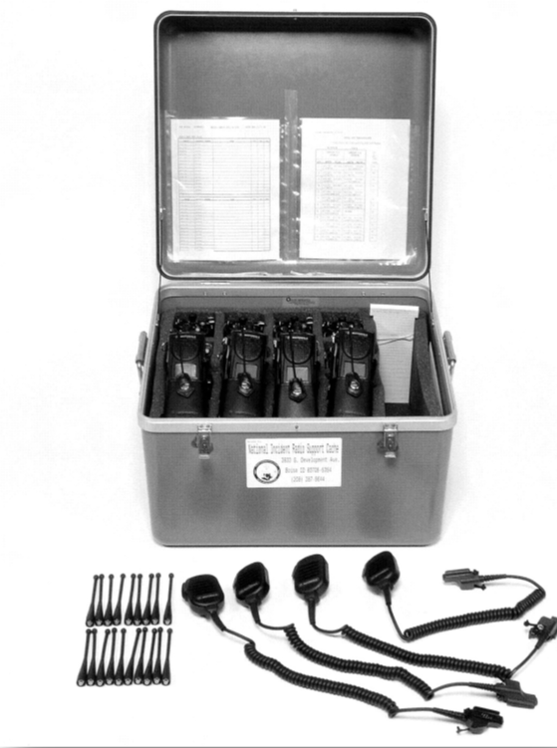

NIICD System Kit Issue

Slide 11
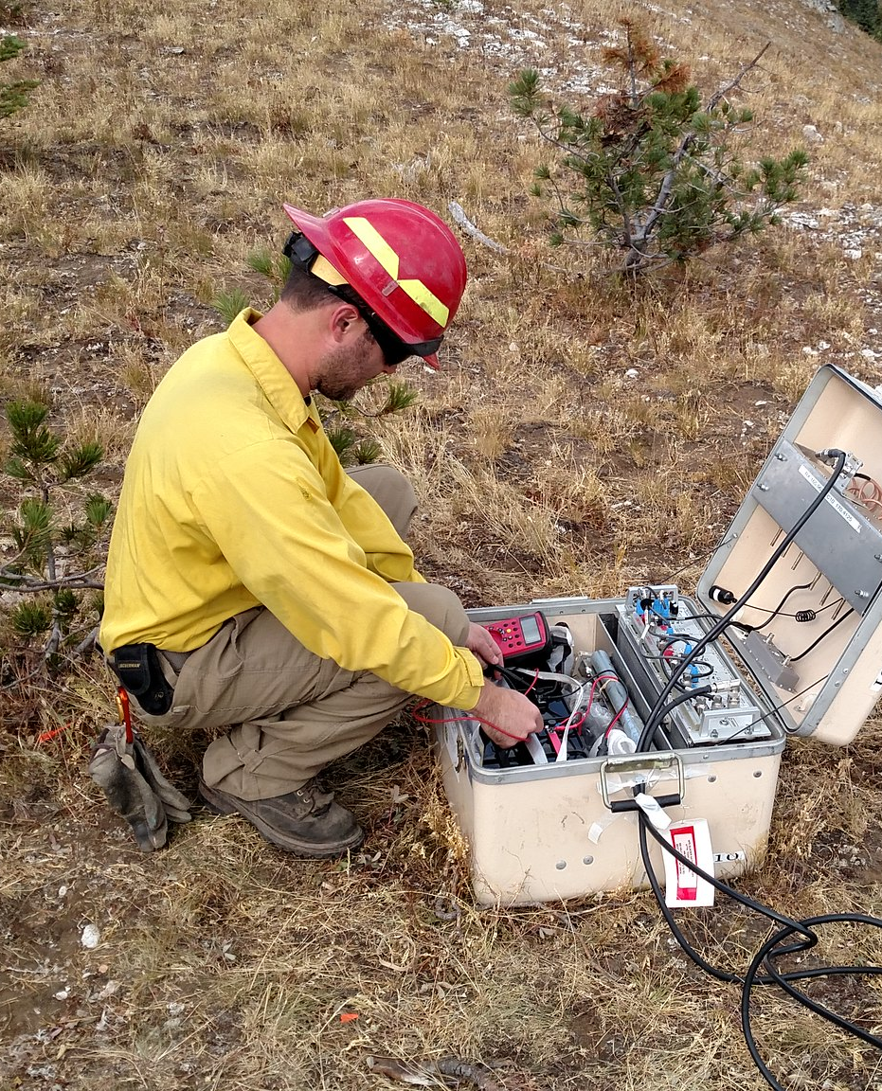
National Incident Supply Caches
Local ordering procedures
Types of channels
Consolidate orders
National resources
Telecommunication kits
Weather sensing kits
Critical item source list
Notes:
Radio set up on Sprague Fire | A firefighter sets up a radio… | Flickr

Slide 12
NFES
National
Fire
Equipment
System

Slide 13
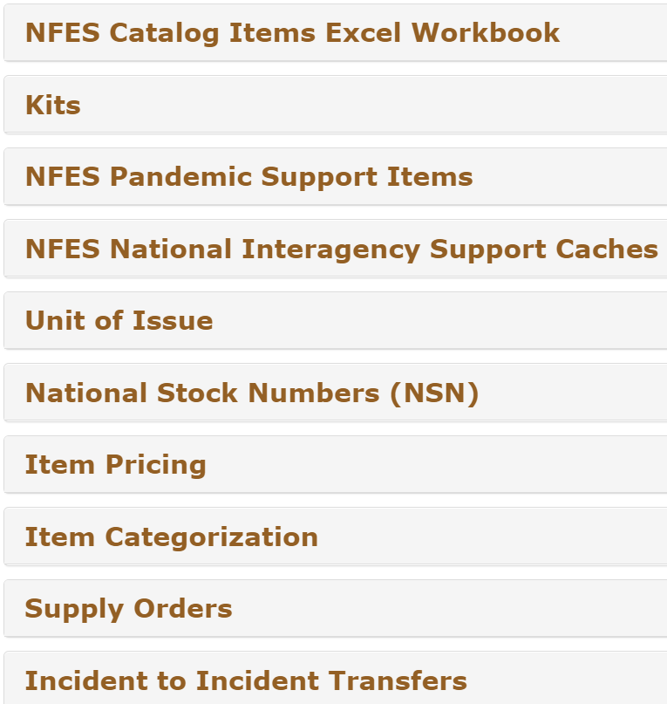
NWCG NFES Catalog - Part 1: Fire Supplies and Equipment, PMS 449-1
https://www.nwcg.gov/publications/pms449-1

Slide 14
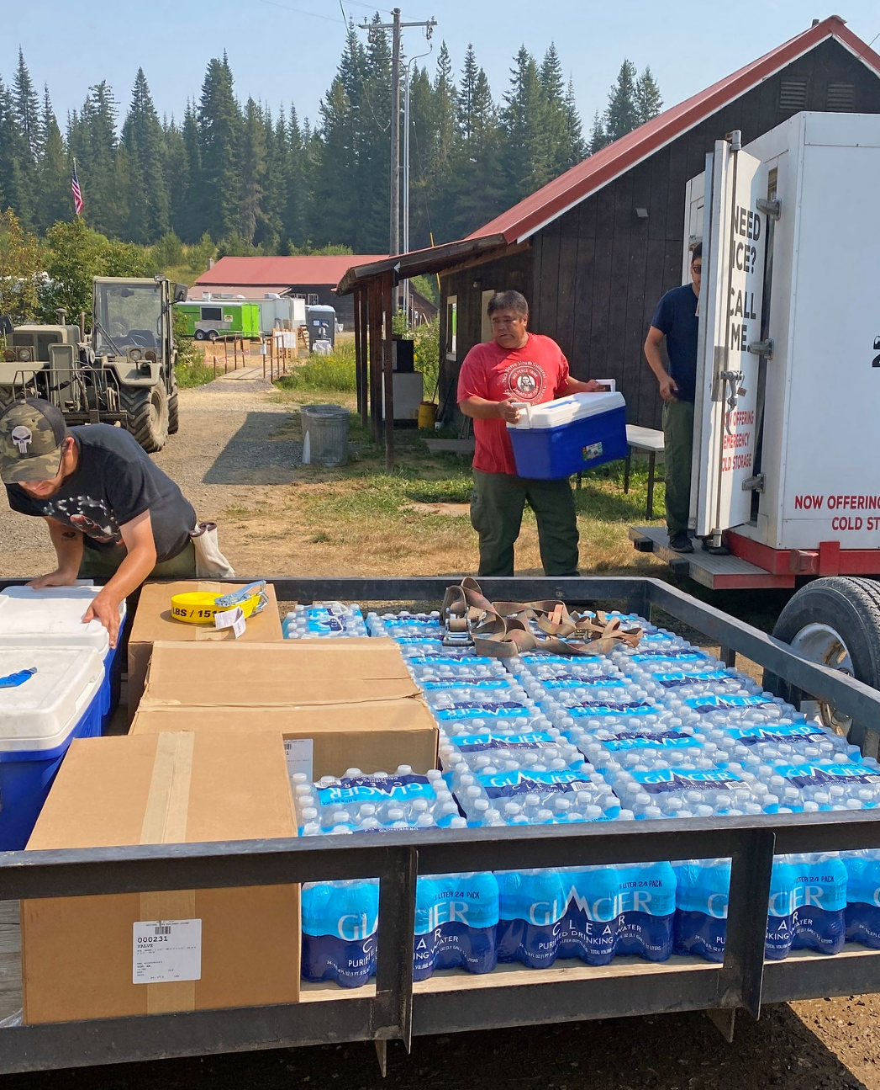
Consumable Items
Items normally expected to be consumed during incident use
Examples:
Batteries
Plastic canteens
Cubitainers
Meals Ready-to-Eat (MREs)
Fusees
Hot food containers
Medical supplies
Notes:
Getting Supplies to Firefighters | Members of Nez Perce Trib… | Flickr

Slide 15
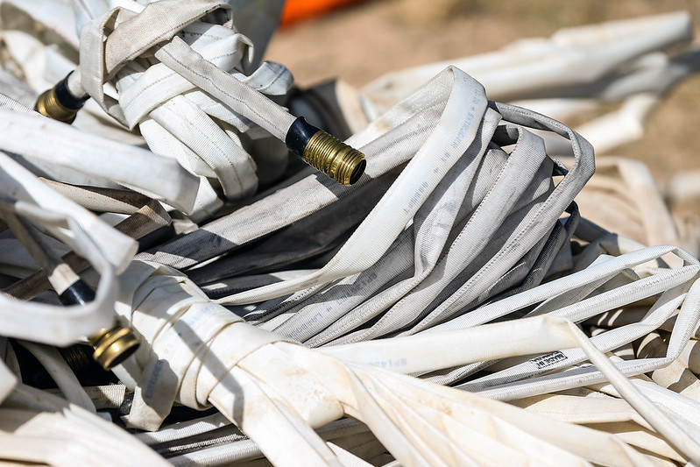
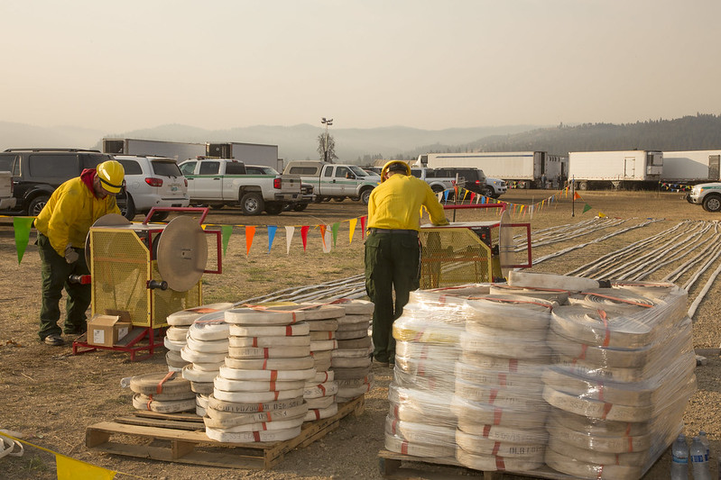
Durable Items
Those cache items considered to have a useful life expectancy greater than one incident
Examples:
Hoses
Clothing
Sleeping bags
Tools
Notes:
Supplies for Firefighters on Pioneer Fire | Firefighters nee… | Flickr
Oil Springs Fire | Bundled hoses used to suppress the Oil Sp… | Flickr

Slide 16
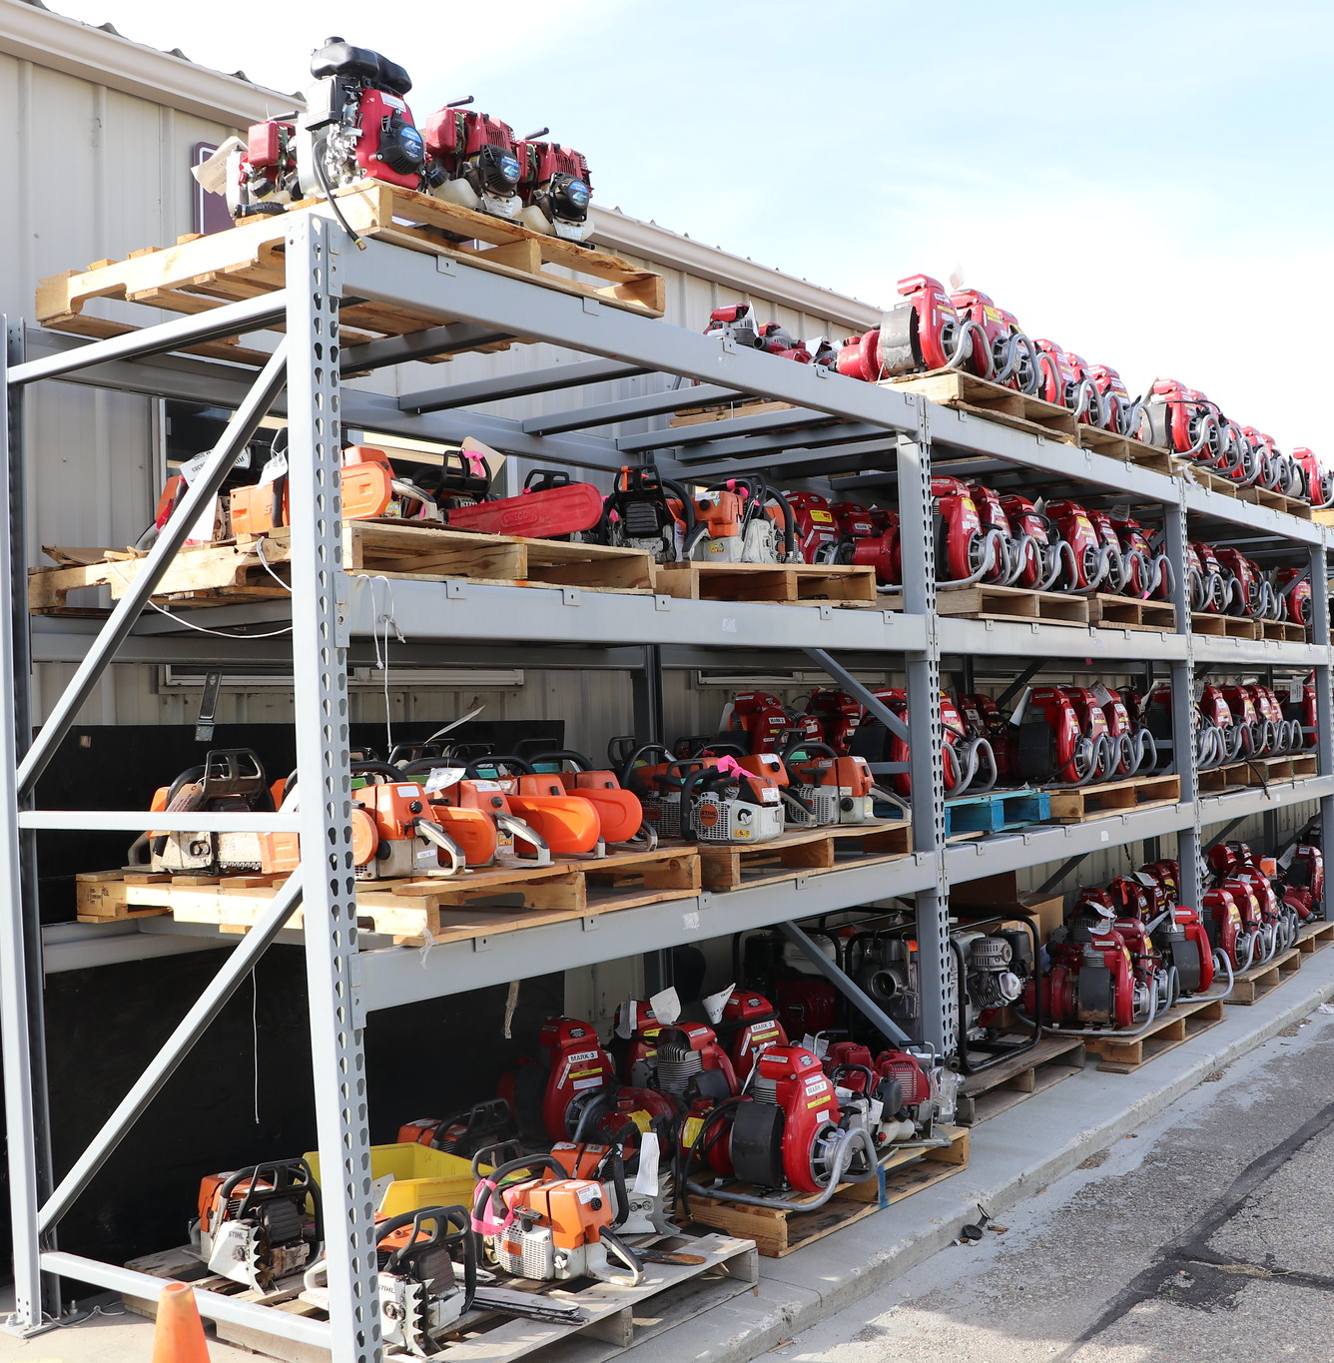
Trackable Items
Those cache items that have a high dollar value and need to be accounted for from time of issue until they are returned to cache
Examples:
Chain saws
Generators
Pumps
Radios
Notes:
Returns Warehouse at NIFC | The Returns Warehouse at NIFC is… | Flickr

Slide 17
Ordering Procedures
Request number
Quantity
Unit of issue
NFES number
Description
Date/time needed
Delivery address/method
Billing address
Latitude/longitude (radios)

Slide 18
Cache Ordering and Potential Problems
Substitution
NFES items that really should be procured locally
Cost effectiveness – combined order
Non-available items
Make sure you know what you are ordering.

Slide 19
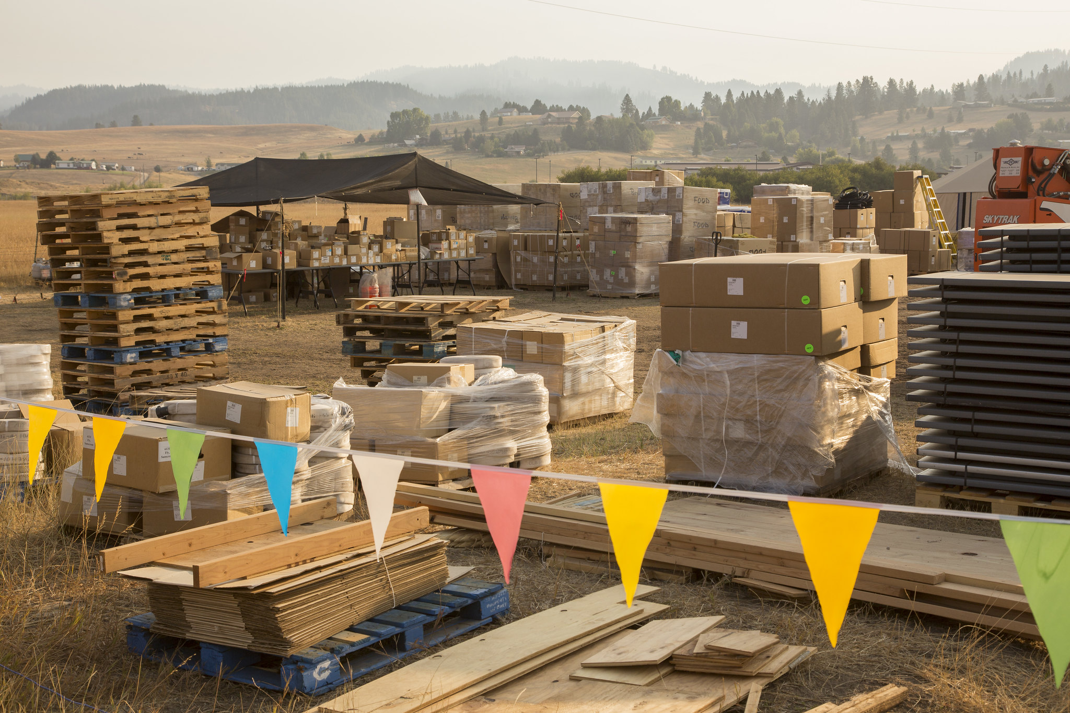
Activity: NFES Catalog
Notes:
Supplies for Firefighters on Pioneer Fire | Firefighters nee… | Flickr

Slide 20
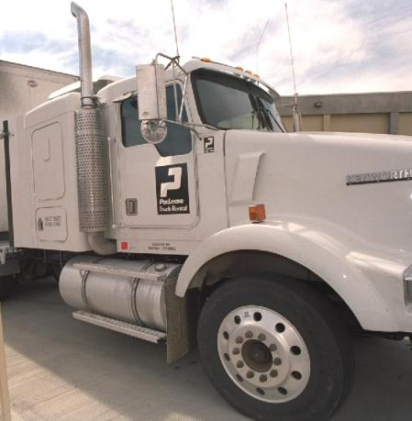
Mobile Cache Vans
Ordering
Cache vans may be ordered from the Geographic Area Coordination Center (GACC), or the order may be directly placed to the cache. Check your local policy.
Using the cache van
Initial supplies support 250 people.

Slide 21
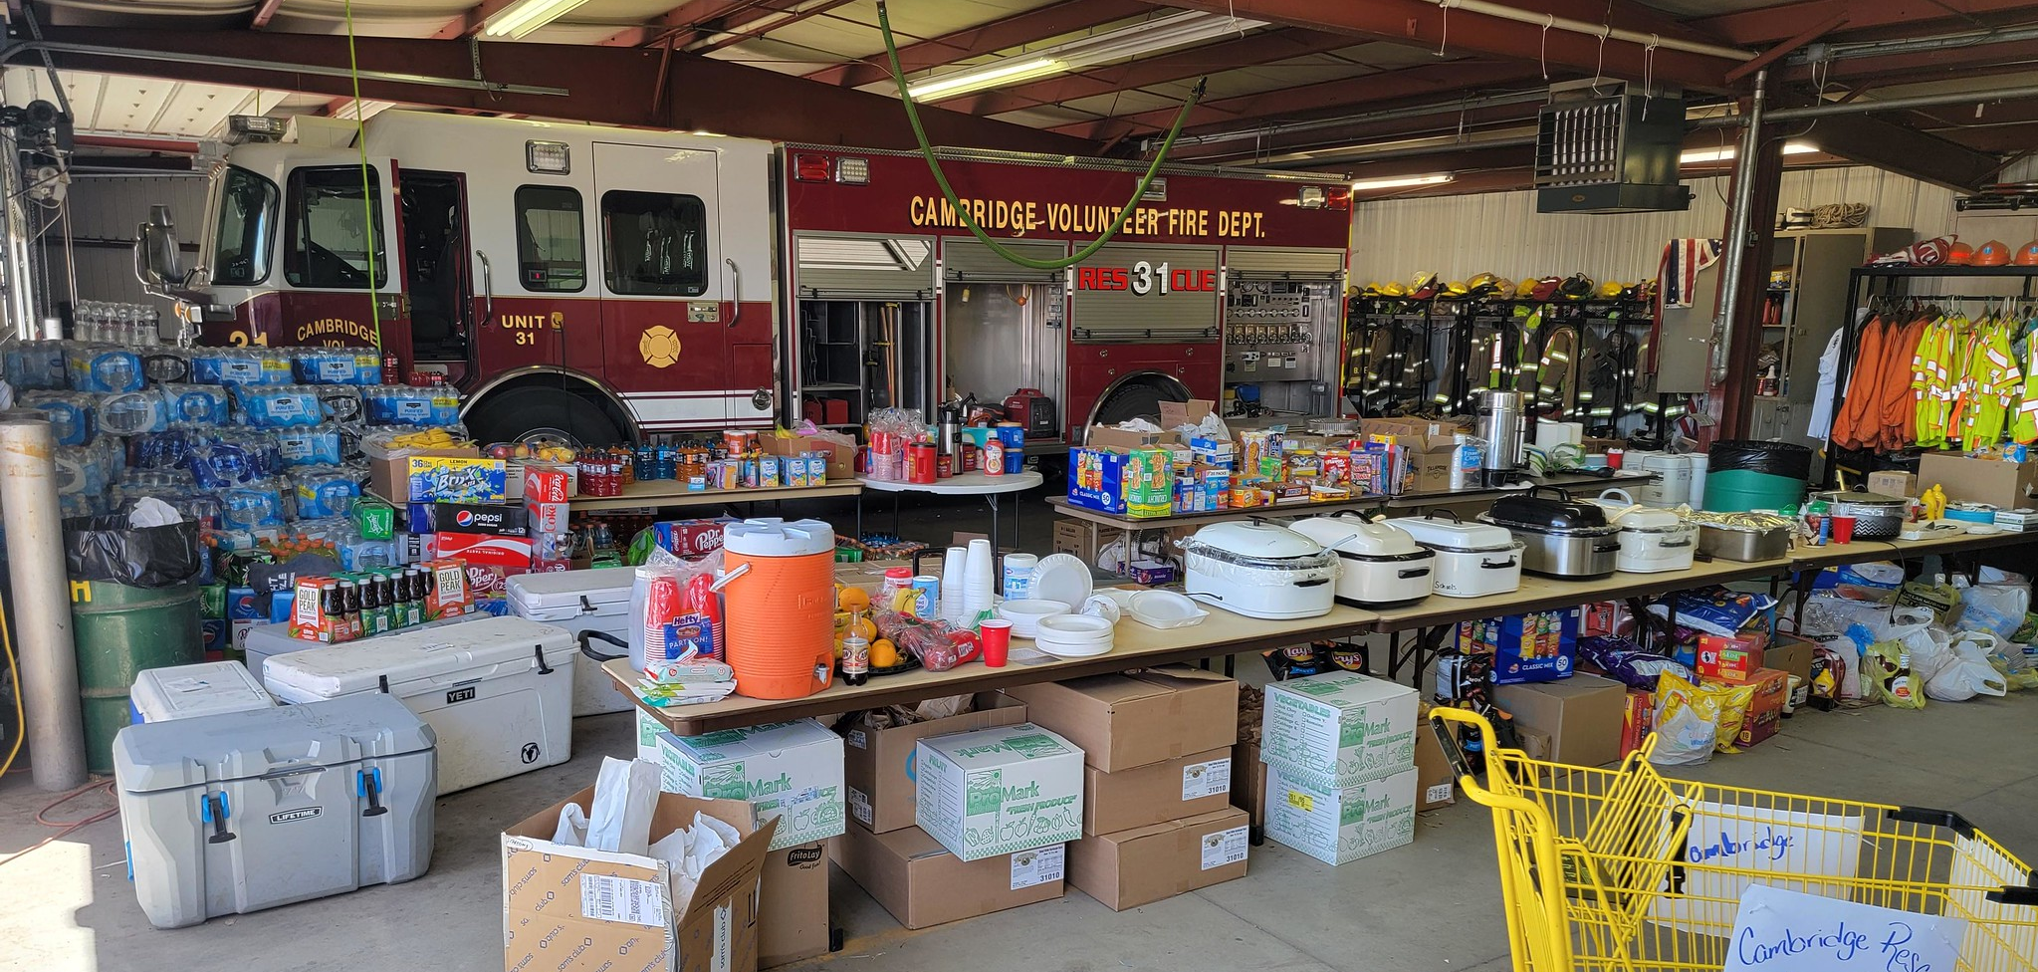
Procurement
Non-cache items are available through local vendors.
Notes:
Road 702 Fire | Community support at the Cambridge Fire Stat… | Flickr

Slide 22

Non-Cache Items Usually Available Locally
Common items
Ice
Fruit
Juice
Uncommon items
Golf carts
Horse feed
Carpet
Lumber

Slide 23
Services
Portable toilet services
Trash removal
Land use agreements
Mobilization center activation
Meals (pre-caterer)
Lodging

Slide 24


BUYTs
Dealing directly with the incident
Procuring supplies for expanded dispatch
Purchasing food and hotel accommodations
Procuring services, supplies, land, and equipment rentals

Slide 25
Shipping and Receiving Methods
Methods
Air freight – Contract/call-when-needed, agency-owned, commercial
Ground freight – Commercial, agency-owned, private/rental
Considerations
Timeframes (date and time needed)
Cost – quantity, cubic ft., weight

Slide 26
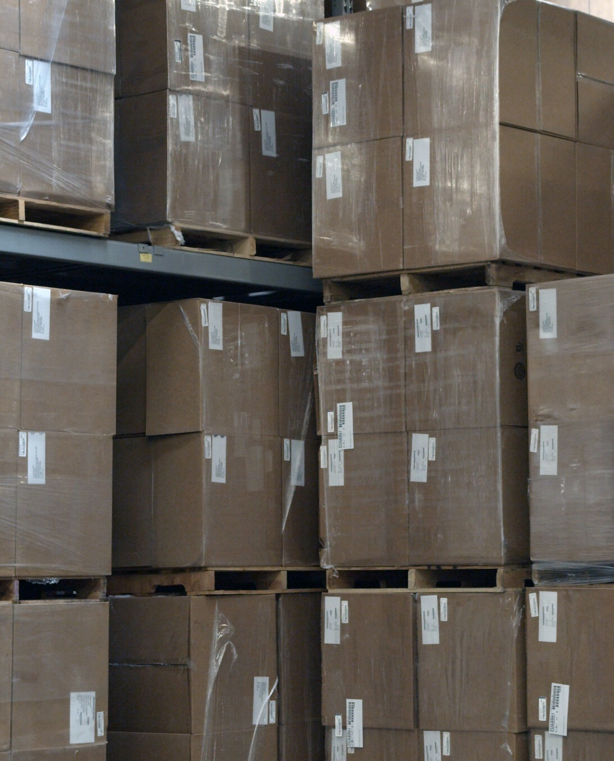
Shipping Status Information
Number of pieces
Date shipped
Shipping mode
Actual time of departure (ATD)/estimated time of arrival (ETA)
Shipping document numbers
Notes:
Great Basin Cache | The Great Basin Cache and Returns Wareho… | Flickr

Slide 27
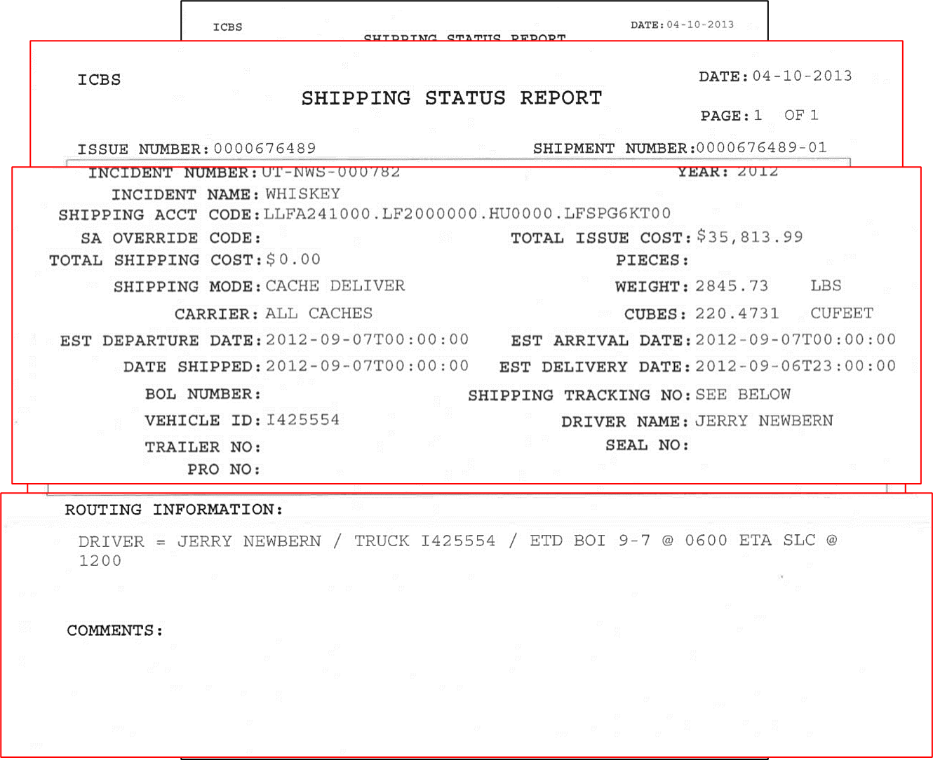
Shipping Status Report

Slide 28
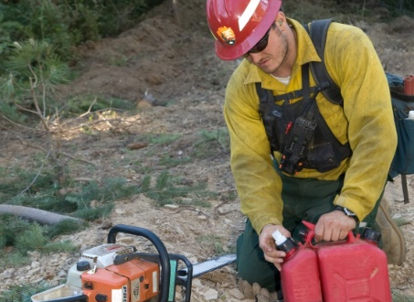
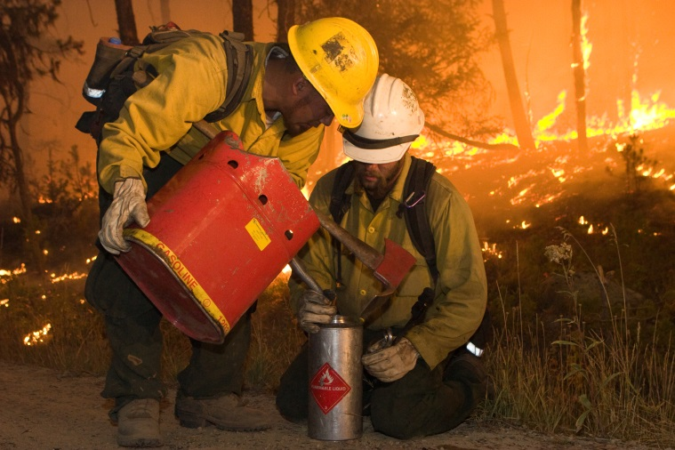
Hazardous Materials
Liquid fuels
Petroleum oil
Fusees
Batteries/battery fluid
Explosives
Compressed gas
Small-arms ammunition
Aerial ignition devices/materials

Slide 29
Demobilization
Requests are usually closed out after all transport information is passed.
Exception: Trackable items
Recycling.

Slide 30
Summary
Caches stock three types of goods:
Consumable
Durable
Trackable
NIICD is a national interagency resource composed of radio systems and kits available for incident communications.
The NFES Catalog contains information about incident fire supplies and equipment stocked by and ordered from the National Interagency Support Caches.
Non-cache items can be procured through local vendors.
BUYTs procure supplies when purchasing requirements go beyond local capabilities.
Shipping and receiving methods include air freight and ground freight.
Reference Hazardous Material Guides, when appropriate.
Usually supply orders are closed after shipping and travel information is passed.

